Slide 1

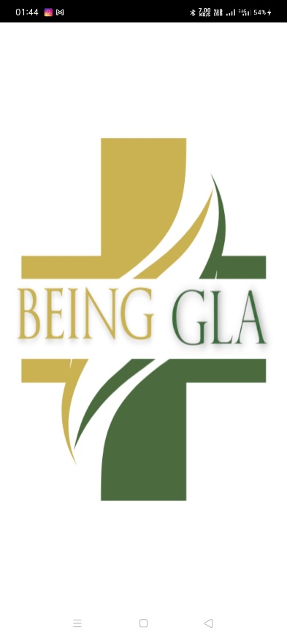
BEING GLA Mental Health App
Presented By:
Muskan Bhardwaj(191500466)
Pragya Sharma(191500560)
Gyanendra Pratap Rai(191500308)
Mentor:
Mr. Manoj Varshney
Assistant Professor
Department of Computer Science & Engineering

Slide 2
OUTLINE:
About the project
Objectives
Technology Used Requirements
Snapshots from the project

Slide 3
About the Project:
Being GLA is an android application made to facilitate users with a solution so that user are able to take better health decisions. Whether you’re looking to better understand your feelings or experiencing anxiety, depression, or high levels of stress, This application is designed to help you to feel better by connecting with counsellors. It is a hassle-free and pinpoint accurate platform with retrieving information of each and everything related to basic healthcare, including information of the best counsellors available. We also provide details of Counsellors to which you can consult and discuss all your queries and also ask for a counselling.
The main goal of the service is to make your decision making easy regarding mental health. At any time, search for therapists and treatments while remaining anonymous, and offer a number of ways to stay engaged, like know about your body mass,how to reduce your mental stress etc .Not the mental health app are meant to supplement a licensed therapist, it can be great tools to help you manage your mental health concerns and treatment.This software is provided as an online only resource so that it may be continually extended and updated.

Slide 4
Objectives:
Mental Health android application are a perfect platform for people to get knowledge about any particular problem. The basic objective of developing this project are:
Ability to talk to a licensed mental health professional
Conversations are private and secure.
Allows you to connect with peers who understand what you're going through
Therapists can diagnose and treat different conditions

Slide 5
Technology Used:
Android Studio-Android Studio is the official Integrated Development Environment (IDE) for android application development. It has a flexible Gradle-based build system .It has a fast and feature-rich emulator for app testing. Android Studio has a consolidated environment where we can develop for all Android devices . Apply changes to the resource code of our running app without restarting the app.
XML-XML stands for Extensible Markup Language.XML is a markup language much like HTML used to describe data. XML tags are not predefined in XML. We must define our own Tags. Xml as itself is well readable both by human and machine. Also, it is scalable and simple to develop. In Android we use xml for designing our layouts because xml is lightweight language so it doesn’t make our layout heavy.In this article we will go through the basic concepts of xml in Android and different XML files used for different purpose in Android. This will help you in writing a UI code to design your desired user interface.
JAVA-Java is a general-purpose, class-based, object-oriented programming language designed for having lesser implementation dependencies. It is a computing platform for application development. Java is fast, secure, and reliable, therefore. It is widely used for developing Java applications in laptops, data centers, game consoles, scientific supercomputers, cell phones, etc. Java plays an important role in development of Android applications because business logic is written in Java. You can say that knowledge of core java is must for the development of android application. Knowledge of advance Java is a plus point for the development. With the knowledge of advance Java,

Slide 6
REQUIREMENTS:
Hardware Requirements
Processor Required: Intel i5
Operating System: Windows 10
RAM: 4GB
Hardware Devices: Computer System
Hard Disk: 256GB
Software Requirements
Technology Implemented: Android Studio
Languages/Technologies Used: JAVA,XML.
Software use for Backend: Google Firebase.
IDE Used: Android Studio
Device: Android
GitHub: GitHub is a code hosting platform for version control and collaboration. It lets you and others work together on projects from anywhere. GitHub Repository: A GitHub repository can be used to store a development project.

Slide 7
THIS IS HOW OUR Application LOOKS
Hope you will like it...

Slide 8
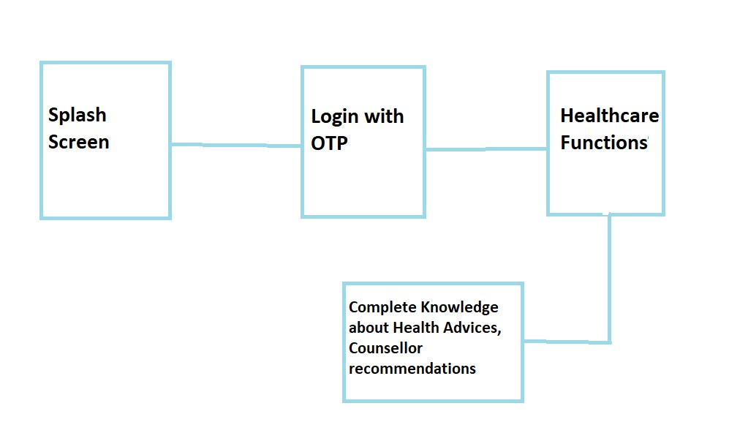
Flow Chart For User:

Slide 9
USER INTERFACE: Splash Screen:

Slide 10
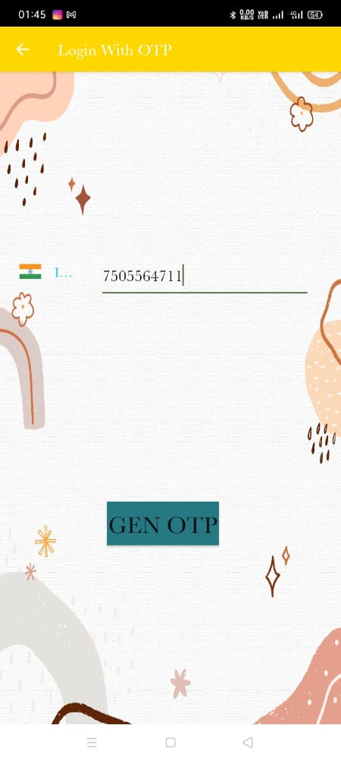
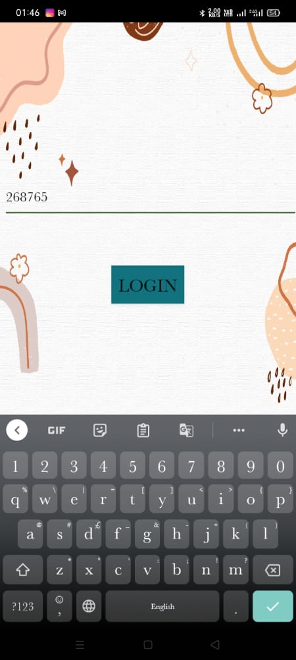
LOGIN WITH OTP:

Slide 11
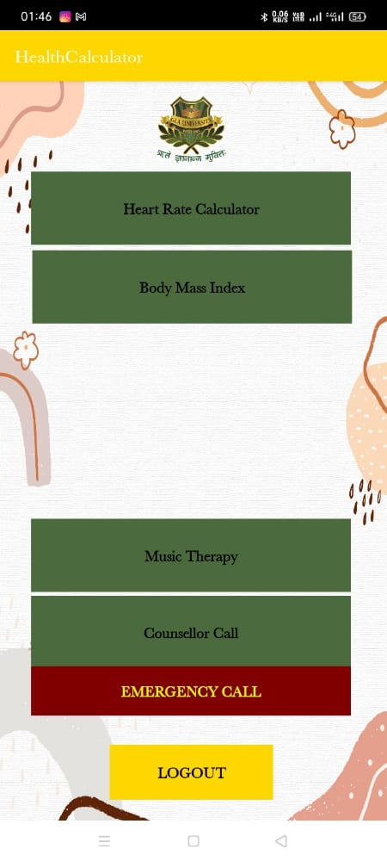
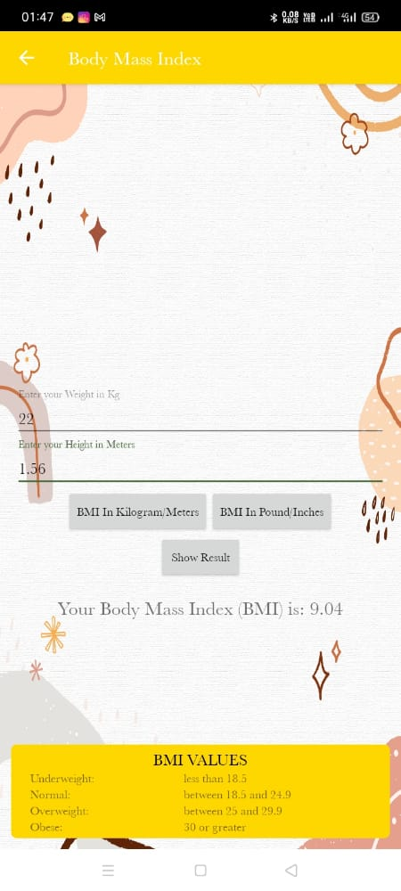
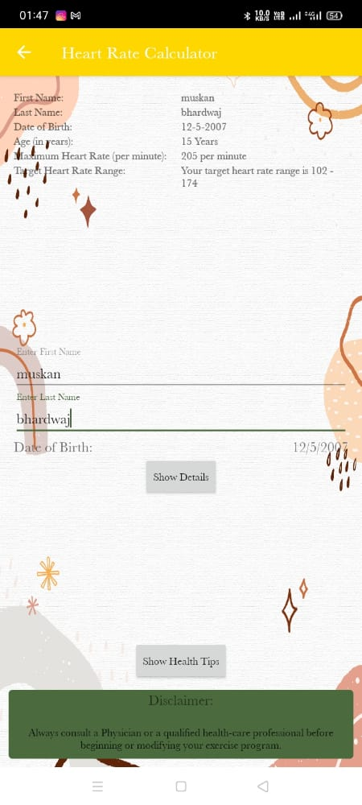
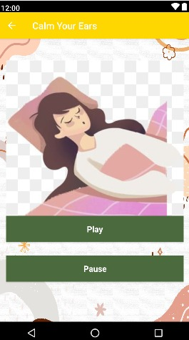
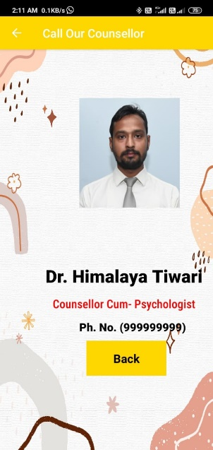
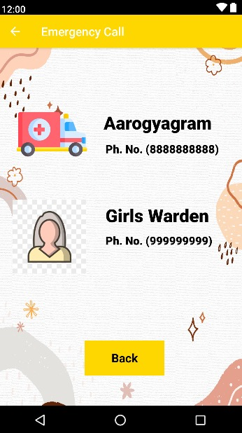
SERVICES:
Heart Rate
Calculator
Counsellor
Call
Emergency
Call
Body Mass
Index
Sleep ASMR

Slide 12
Project
The source of our project (including all the project work, documentations and presentations) will be available at the following link –
https://github.com/Mu613/BeingGLA

Slide 13
THANK YOU

